Slide 1

Azure In Action
CosmosDB, Functions and ServiceBus in Perfect Harmony
There's so many parts to Azure, it's sometimes hard to decide what to use and when. Do I use TableStore or CosmosDB? Would BlobStore be better? Should I host a full-fat .Net service in a VM, or stand up an ASP.Net Core WebApi? What about functions? The choices are myriad.
In this talk I'll describe how at Landmark we made these kind of decisions as we implemented some new features in our product. I'll talk about the questions you need to ask to make those decisions, where we went wrong, and how we succeeded in the end.
I'll describe in detail how we used CosmosDB, Azure Functions and Service Bus together to provide a Compliance Audit trail feature that would scale properly, work reliably, be trivial to use, and that wouldn't break the bank.
W: https://www.hammond-turner.org.uk
E: joel@Hammond-turner.org.uk
T: @Rammesses

Slide 2

Azure In Action
CosmosDB, Functions and ServiceBus in Perfect Harmony

Slide 3
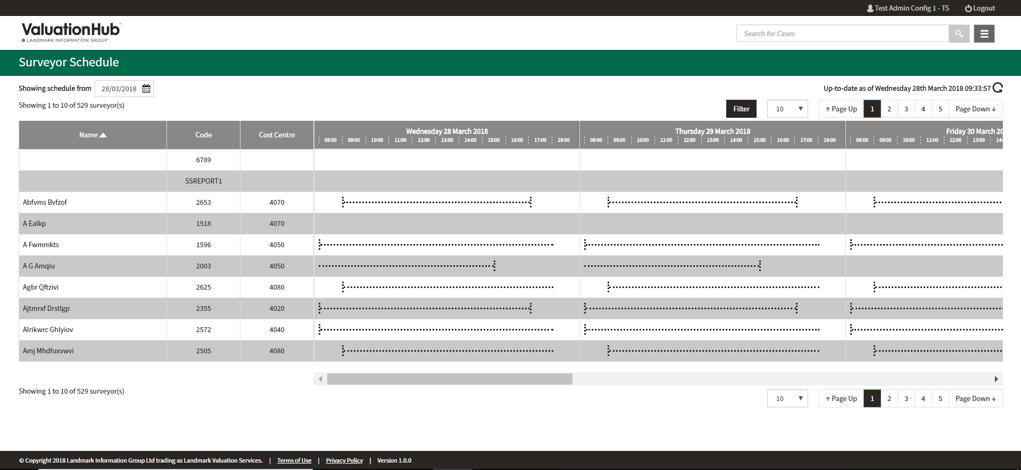
Some Background
Landmark Valuation Hub
“End to end residential property transaction lifecycle management, seamlessly coordinating Lender and Surveyor case management through configurable workflow. Valuation Hub is your window into the Secure Panel Network, providing Lenders access to the community of UK Surveyors, and enabling Surveyors to complete cases securely, accurately and on time, every time”

Slide 4

The Requirements
Audit all the things!
Originally from http://hyperboleandahalf.blogspot.co.uk

Slide 5

The Requirements
Audit Data Changes
New Cases
Case Bookings
Surveyor Holidays
Audit User Activity
Login
Logout
Activities
Audit System Activity
Processes Run Successfully
Processes Skipped (and why)
SMSs / Emails Sent
Visible in the UI
Filterable / Searchable
“Who changed what, when, and why?”

Slide 6



The (Technical) Requirements
The Easy Bits
Reliable
Scalable
Long-Term
The Difficult Bits
Audit *anything*
Simple to use / impossible to get wrong
Easy “Queryability”

Slide 7
The Problem
If not EventStore on-premise… WHAT?

Slide 8

Weebl & Bob © Jonti Picking http://weebls-stuff.com/toons/category/toons/wab/
Notes:
Talk about why Azure vs AWS
We use both in-house. Azure deemed more mature for SAAS / FAAS etc – use AWS for PAAS

Slide 9
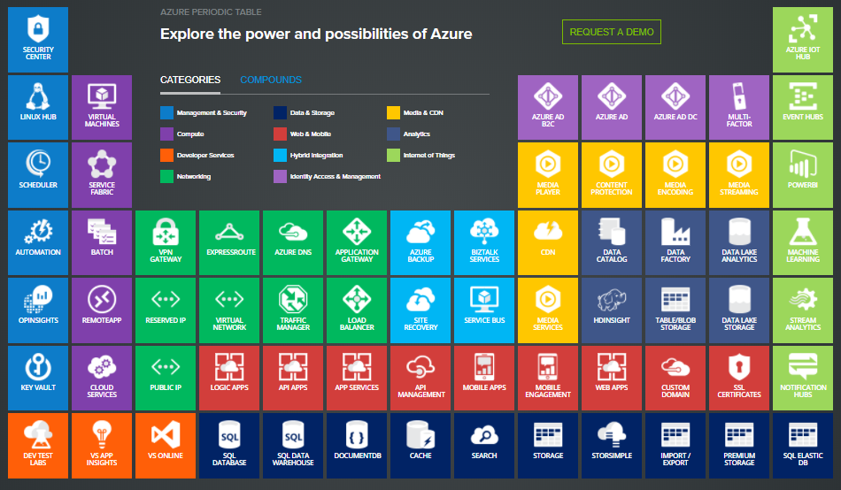
The Problem(s)
Azure is big. *
Really big. You just won't believe how vastly, hugely, mind-bogglingly big it is.
> 150 Services
20 Categories
Azure Periodic Table from http://www.concurrency.com
Service Catalog from https://azure.microsoft.com/en-gb/services/
* Apologies to Douglas Adams

Slide 10
The Problem(s)
Three critical decisions
Storage
Hosting
API

Slide 11
Decision One - Storage
Big numbers From our internal review:
5,000 Cases processed / day
75 auditable operations / Case / day
30k / audit event
11.25Gb of change data / day!

Slide 12
Decision One - Storage
Azure SQL Database
Managed, relational SQL Database as a service
Azure Cosmos DB
Globally distributed, multi-model database for any scale
SQL Data Warehouse
Elastic data warehouse as a service with enterprise-class features
Azure Database for PostgreSQL
Managed PostgreSQL database service for app developers
Azure Database for MySQL
Managed MySQL database service for app developers
Blob Storage
REST-based object storage for unstructured data
Queue Storage
Effectively scale apps according to traffic
Data Lake Store
Hyper-scale repository for big data analytics workloads
Table storage
NoSQL key-value store using semi-structured datasets

Slide 13




Decision One - Storage
Blob Store
Table Store

Slide 14
Decision One - Storage
Blob Store
Table Store
Cheapest
(from £0.002/GB per month)
Simplest
Limited Data Partitioning
by container or virtual path
Not Searchable
Would need separate search / index service
Cheap
(from £0.0522 per GB per month)
More Flexible
Good Data Partitioning
by key
Searchable via Table API

Slide 15
Decision One - Storage
Azure CosmosDB
SQL Server / PostgreSQL
Cheap(ish)
(from £0.18 / Gb month storage plus £17.28 / month RUs)
Infinitely scalable
(fairly linear scaling costs)
Highly reliable
Searchable
SQL Queries
Not Cheap
(from £56 per month plus storage )
Costs lots to scale
H/A from £580+ per month
Highly Reliable
Searchable
It’s SQL Server!
Notes:
https://azure.microsoft.com/en-gb/pricing/details/sql-database/managed/
32Gb / month included
£0.06 per additional 32Gb / month
Plus backup
Max 8Tb = rotate data after 3 years!

Slide 16
Decision One - Storage
Azure CosmosDB
Table Store
Cheap(ish)
(from £0.18 / Gb month storage plus £17.28 / month RUs)
Infinitely scalable
(fairly linear scaling costs)
Highly reliable
Searchable
SQL Queries
Cheap
(from £0.0522 per GB per month)
More Flexible
Good Data Partitioning
by key
Searchable via Table API

Slide 17
Decision One - Storage
Azure CosmosDB
Table Store
Secure
Data encrypted at rest
Easy H/A support
Flip the switch for Geo-Replication
Easy to manage
Ops love it!
Not Secure
Have to hand-roll encryption
Harder H/A support
Either managed by Microsoft or using 3rd party tools
Harder to manage
W I N N E R!
Notes:
Table Store requires additional work or 3rd party tool
CosmosDB has Geo-Replication OOB – better for Ops

Slide 18
Costings for CosmosDB
5,000 Cases / day - 30k / record, 75 records / Case
11.25Gb Storage / day – peak 2.235Gb / hour
375,000 operations / day – peak 75,000 / hour
Item | Cost / month | Notes
Storage | £104 / month | Increasing by £104 / month
Data Transfer | £22 / month
1,000 Compute Rus | £44 / month | Based on peak usage
Notes:
Already have an archive policy for the product – can implement audit archiving ”down the line”

Slide 19
Decision Two - Hosting
App Service
Quickly create powerful cloud apps for web and mobile
Logic Apps
Automate the access and use of data across clouds without writing code
Web apps
Quickly create and deploy mission-critical web apps at scale
Functions
Process events with serverless code
Cloud Services
Create highly available, infinitely scalable cloud applications and APIs
API apps
Easily build and consume Cloud APIs
Service Fabric
Develop microservices and orchestrate containers on Windows or Linux
Container Instances
Easily run containers with a single command
Virtual Machines
Provision Windows and Linux virtual machines in seconds
Or On-Prem Hosted?

Slide 20
Decision Two - Hosting
Azure Functions
Cheap!
£0.000012 GB-s
400,000 GB-s FREE!
Flexible
Bind to HTTP – it’s a WebAPI!
Bind to ServiceBus – it’s a MessageProcessor!
Bind to CosmosDB – It’s an EventProcessor!
Write in C# to get all the benefits of testing / reuse
Serverless FTW!
W I N N E R!

Slide 21
Aside – Audit Maxims
Audit is not the same as Logging.
Audit is a critical component and cannot be turned off - failure to audit is treated as a system failure.
Audit events are immutable; they cannot be changed once written.
Audit records should be written by your domain / behavioural service layer.
Audit records must contain as much useful information relating to the action as possible
The call to the audit service must be made immediately after the action it is auditing
The related action must be successful before an attempt to write an audit record is made.
Notes:
Audit is not the same as Logging.
Logging is used to provide low level information on system but is not intended to be used as an audit of actions. Critically logging can be turndc down, off or even fail and the system continue to function.
Audit is a critical component and cannot be turned off - failure to audit is treated as a system failure.
Audit events are immutable; they cannot be changed once written.
Audit records should be written by your domain / behavioural service layer.
They should not be written by your front-end / web-api layer.
Audit records must contain as much useful information relating to the action as possible, specifically:
Event Type (required) - All event actions must be represented as verb phrases in the past tense with spaces so that they can be readily humanised.
Description (optional) – Additional descriptive text of the audit event where it adds value. e.g. the reason that an SMS was not sent such as “User opted out”
Target Type / Target Id (required) - The identifier and name of the entity that the audit relates to e.g. the Case, this can be different from the Data type.
Data - Details relating to the audit record e.g. the Case, an Attachment.
The call to the audit service must be made immediately after the action it is auditing. i.e.
i) Write updated case record. ii) Audit "case updated".
The related action must be successful before an attempt to write an audit record is made.
Audit must not be called in parallel to the related action - do not create a new thread for the call to audit (but do use await).
Failure of the related action means that the success audit must not be attempted.
You may audit the failure if the business process / behaviour requires it.
Audit records must not contain any of the following whether valid or invalid:
passwords
database connection strings
access tokens
encryption keys
Audit records will, by design, contain PII (personal identifiable information) data.

Slide 22
Decision Three - API
K.I.S.S.!
Why even an API?
Strongly Typed
Versioned
Delivered as a NuGet package
We got it wrong with attempts 1-3…
Too complex to use correctly

Slide 23
Aside: The Evolution of an Audit API
// 1: Just the facts, ma’am dynamic stuff = new { ... }; await this.client.AuditAsync(stuff);
// 4: Finally correct var request = AuditRequest.AsChangeTo(myThing, t => t.Id.ToString()) .WithData(myThing, t => t.Id.ToString()) .AsEvent("Updated Thing") .WithDescription("Updated thing " +
" because " +
" reasons"); await this.client.AuditAsync(stuff);
// 2: Adding a bit of structure dynamic payload = new { ... }; var stuff = new AuditEvent( typeof(Thing), myThing, myThing.Id.ToString, "AnEvent", payload); await this.client.AuditAsync(stuff);
// 3: All-singing, All-dancing - still not perfect dynamic payload = new { ... }; var request = AuditRequest.For(myThing, t => t.Id.ToString()) .As("AnEvent") .WithPayload(payload); await this.client.AuditAsync(stuff);

Slide 24
Decision Three - API
Direct HTTP API
Service Bus
Simple to implement
Needs retry policy implementation (Polly)
What about when Audit fails?
Also simple to implement
Provides queueing / retry OOB
Fire-and-Forget
Does have payload limits
W I N N E R!

Slide 25
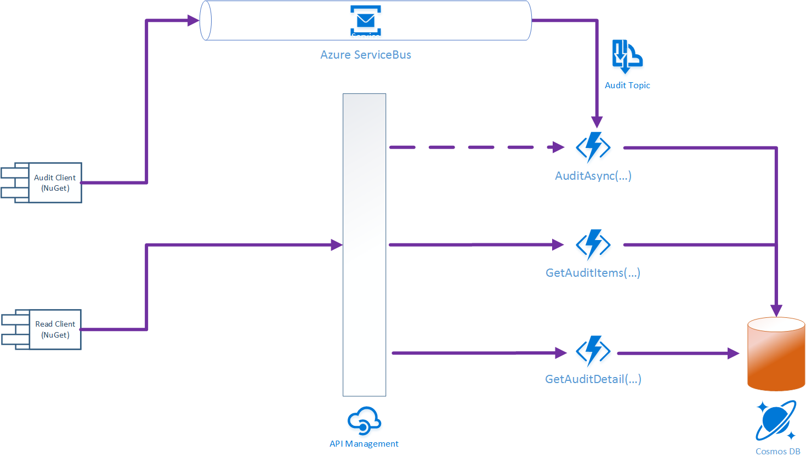
The Architecture (in Pictures)

Slide 26

Let’s See Some Code!
https://github.com/JoelHT-Landmark/CloudAudit

Slide 27
In Summary
Auditing is hard !
Maxims
Cloud is great, but Azure is BIG!
154 services!
Fourth attempt worked!
Storage – CosmosDB
Cheap, flexible, searchable
Secure, H/A
Hosting – Azure Functions
Cheap, flexible, C# codebase
API – Fluent, strongly typed
NuGet package
K.I.S.S.
Service Bus for “Fire-and-Forget”
W I N N E R!

Slide 28
Questions?
?

Slide 29
Azure In Action
CosmosDB, Functions and ServiceBus in Perfect Harmony
W: https://www.hammond-turner.org.uk
E: joel@Hammond-turner.org.uk
T: @Rammesses

